Slide 1
Toro-4
PASSENGER BRIEFING
This briefing is based on information from the TORO-4 User Manual

Slide 2
Risk Awareness & safety features

Slide 3
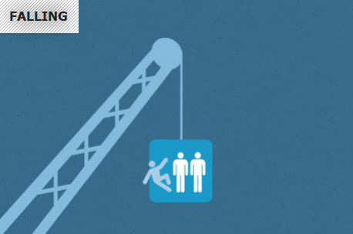
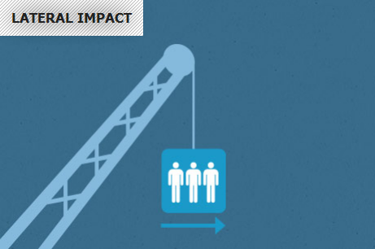
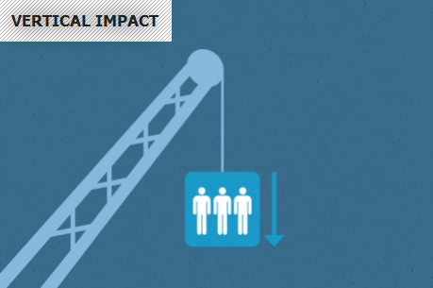
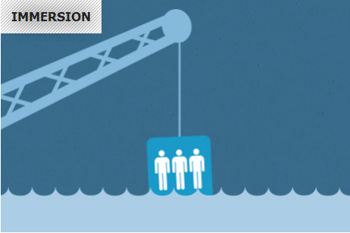
Key Risks
Notes:
3
3

Slide 4
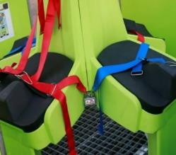
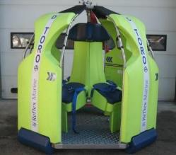
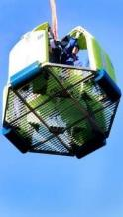
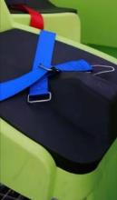
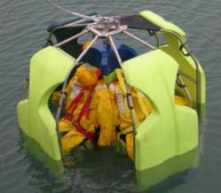
Designed to Protect
FALL PROTECTION
SIDE IMPACT PROTECTION
Fitted with lap strap or
3 point harness
Rugged stainless steel protection frame
HEAVY LANDING PROTECTION
IMMERSION
Specially formulated materials used for seat cushions and feet, as well as an ergonomic seated position protects passengers from heavy landings
Flotation and self-righting

Slide 5
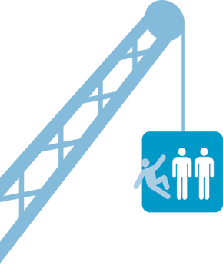
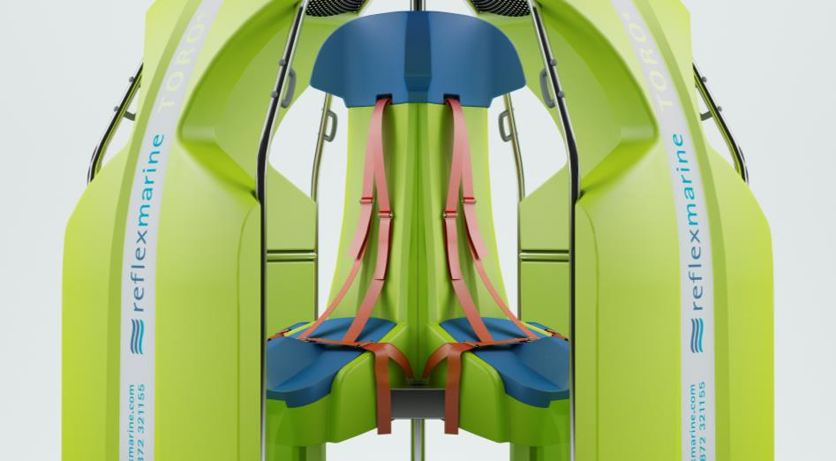
Fall Protection
55% of recorded incidents involve falling
Falling – Losing grip, knocked off, jumping to avoid collision
Grab handles
Quick release
3-point harness

Slide 6
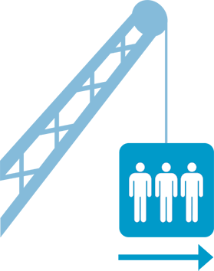
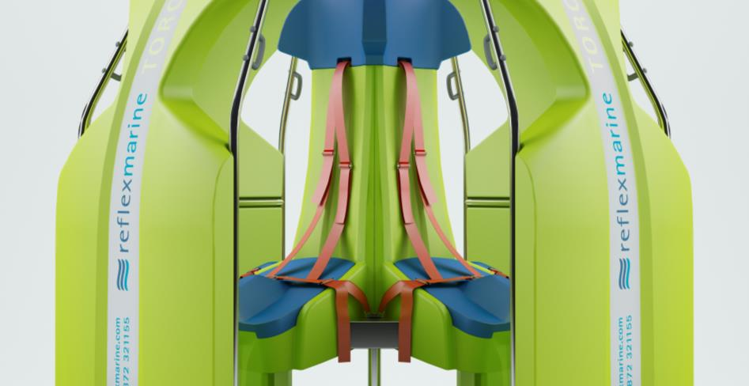
Side Impact Protection
Lateral impact protection of 2 m/s
Calculated and tested against the weakest 5% human spines and neck
Stainless steel frame
Foam-filled polyurethane buoyancy impact protection

Slide 7
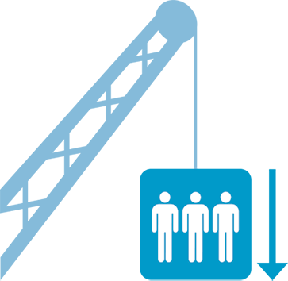
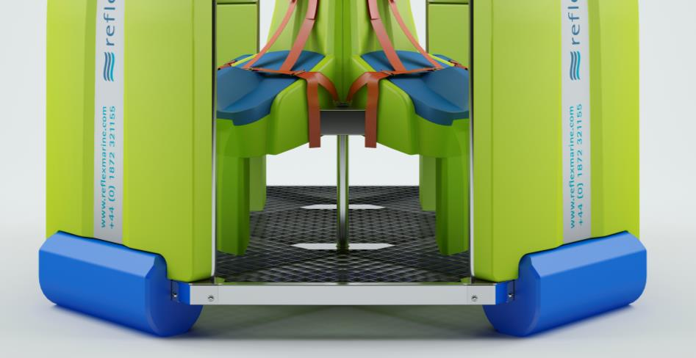
Heavy Landing Protection
Vertical impact protection of 2 m/s
Calculated and tested against the weakest 5% human spines and neck
Shock absorbing feet

Slide 8
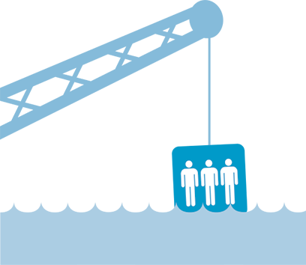
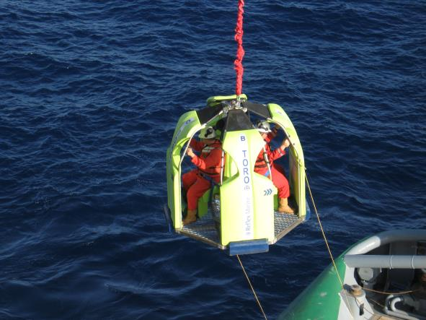
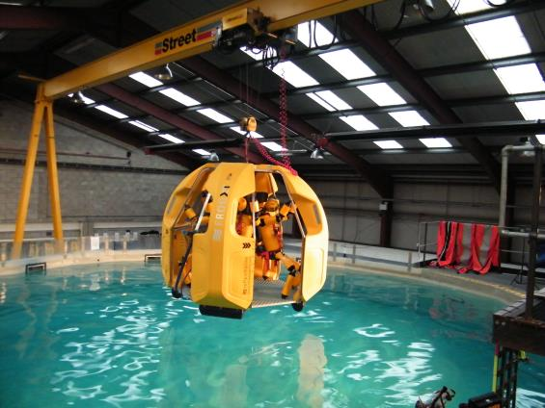
Immersion Protection
Self-rights up to 180° from inverted vertical position

Slide 9
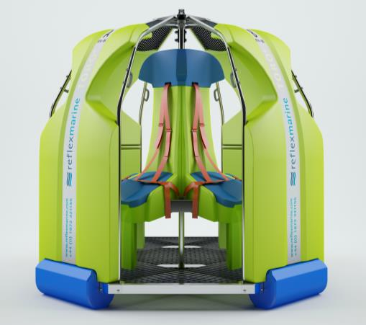
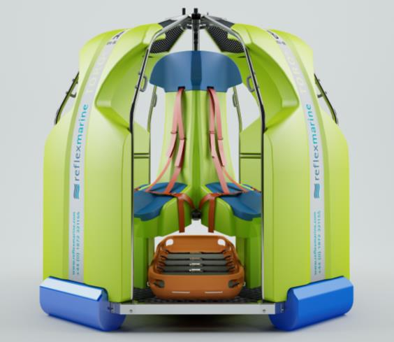
Other Features
4 person or 2 persons + stretcher capacity
Suitable for MedEvac transfers
Suitable for medium volume crew changes
SWL of 440kg
CE Marked
ABS Approved

Slide 10
Using the toro-4

Slide 11
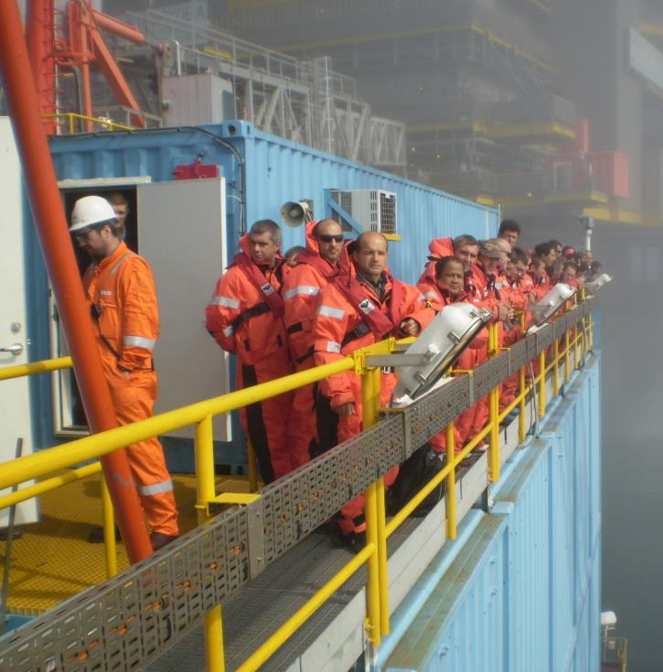
Personal Protective Equipment
Personal Floatation Device
Head Protection
Survival Suit (if required)
Other Operator specific PPE requirements

Slide 12
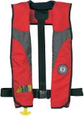
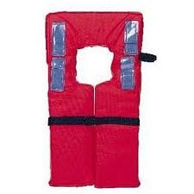
Personal Floatation Devices
Type | Image | Recommended | Comments
Manual inflatable lifejacket |  |  | 275N min rating Automatically inflatable may also be used
Yoke Style Lifejacket |  |  | Can interfere with operation of seat harness

Slide 13
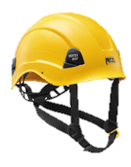
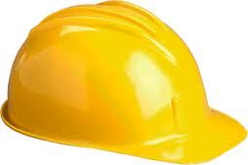
Head Protection
Type | Image | Recommended | Comments
Working at Height Helmet |  |  | Chin strap for secure fit Back of helmet should not interfere with seat
Hard Hat |  |  | Insecure fit Can interfere with seat

Slide 14
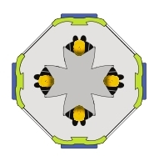
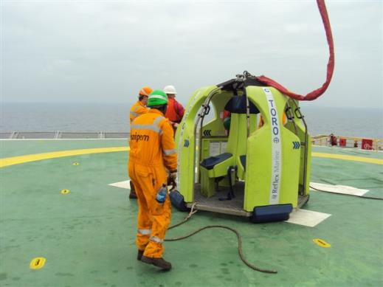
Before Transfer
Watch the User Briefing video
Check your life jacket is fitted correctly
Deck crew will then assign you to a specific seat
Await entry instructions

Slide 15
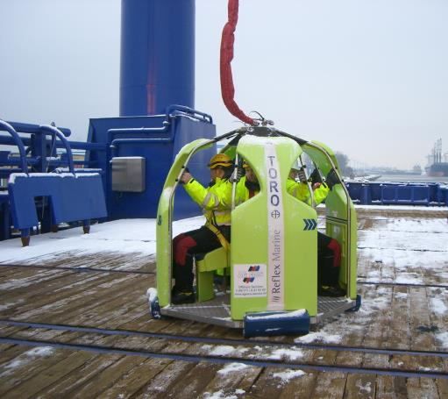
Entry
Enter carrier and take the seat in front of you
Fasten seat harness
Keep hands and feet inside the carrier
Hold the grab handles
Place feet flat on flooring

Slide 16
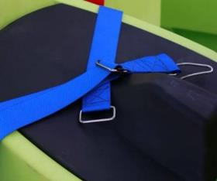
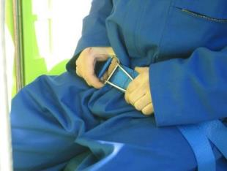
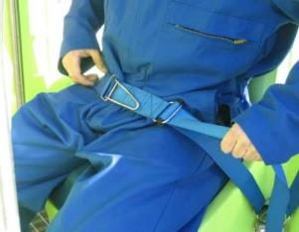
Fastening Lap Strap
Lap Straps will have been prepared by the deck crew
Take the lap fastener clip and feed through the eye
1
2
Fold over clip
Pull lower straps to tighten around waist
3
4

Slide 17
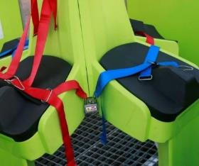
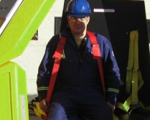
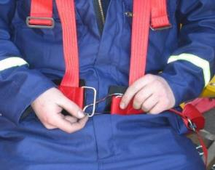
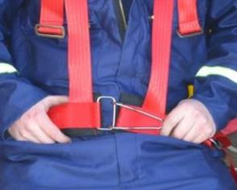
Fastening Seat Harness
Seat harnesses will have been prepared by the deck crew
Insert each arm into shoulder harness
1
2
Take the lap fastener clip and feed through the eye
Fold over clip
3
4

Slide 18
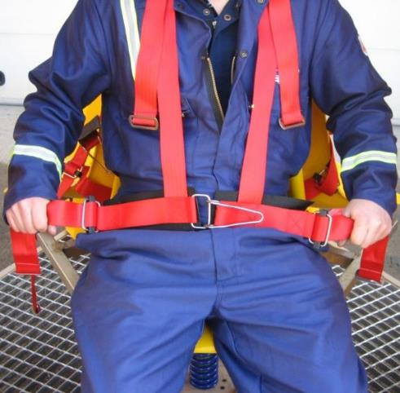
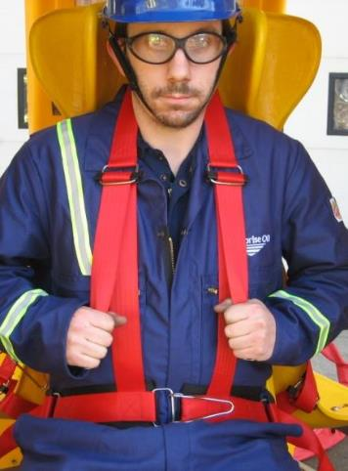
Fastening Seat Harness
PULL LOWER STRAPS FIRST to tighten around waist
PULL UPPER STRAPS SECOND to tighten fit around shoulders and chest
5
6

Slide 19
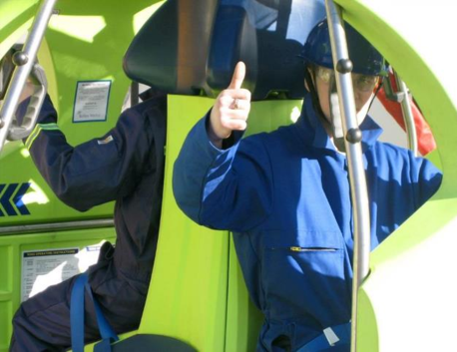
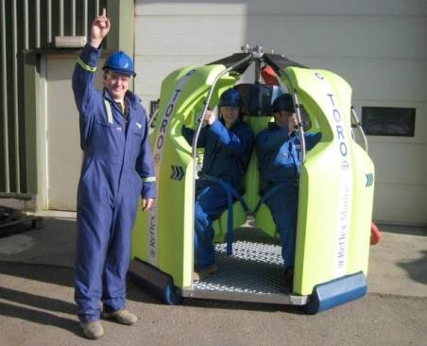
Ready for Transfer
Give a ‘thumbs up’ to indicate you are ready
Deck crew will carry out final check of your seat harness
During transfer:
Remain seated
Do not unfasten seat harness
Keep hands and feet inside at all times
Follow instructions from deck crew at all times

Slide 20
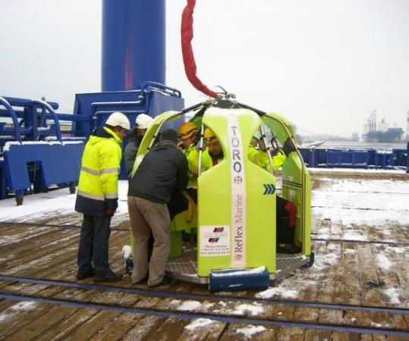
Exit
Await instructions from deck crew to unfasten seat harness
Exit in and orderly fashion
Remain clear of lifting assembly
Proceed to safe area as instructed
Return life jacket

Slide 21
Emergency Procedure
The deck crew will shout “OUT-OUT-OUT”
Release safety harness and leave the carrier immediately
Deck crew will advise and direct you to a safe area
If the transfer is interrupted whilst between vessel and installation:
Remain seated and strapped in
Recovery procedures will be initiated
Await instructions

Slide 22
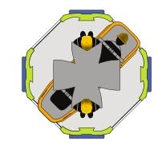
MedEvac Capability
Safe, comfortable and secure environment for walking casualties
Stretcher capability for serious injuries
Capacity for 2 supporting passengers during transfer
Central column can be used to hang I.V/medical equipment
Known medical reasons for use of TORO– broken arms, broken legs, eye injuries, suspected heart attacks, back injuries

Slide 23
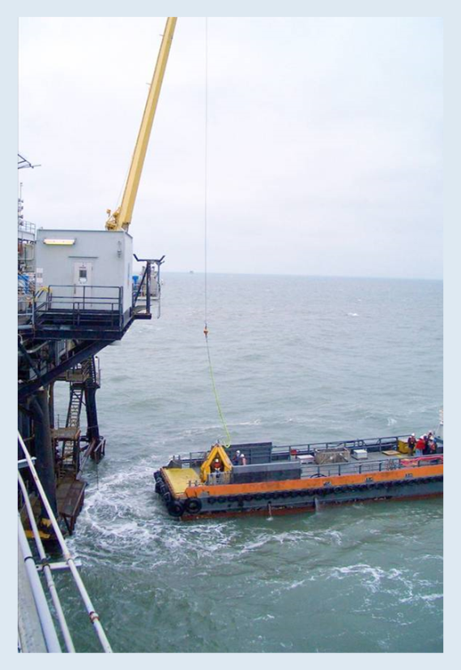
Feedback & Reporting
Feedback is important to improve:
Safety and comfort
Procedure and control
Operating performance
Equipment condition
Report all incidents and near misses no matter how small they may seem, if in doubt ask

Slide 24
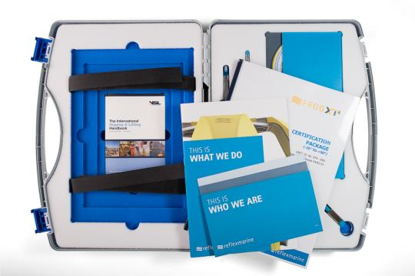
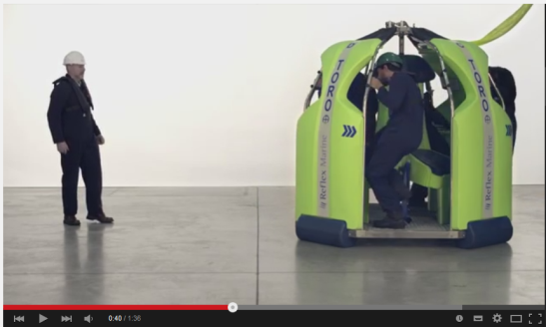
Resources
Here are some useful links;
TORO-4 Passenger Briefing Video
TORO-4 Stretcher Briefing
General Briefing Videos
www.reflexmarine.com

