Slide 1
FROG-6
PASSENGER BRIEFING
This briefing is based on information from the FROG-6 User Manual

Slide 2
Risk Awareness & safety features

Slide 3
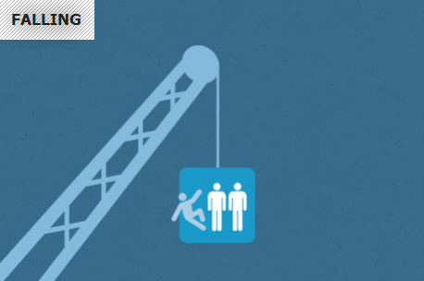
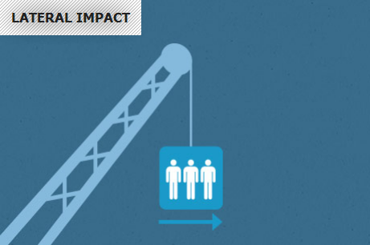
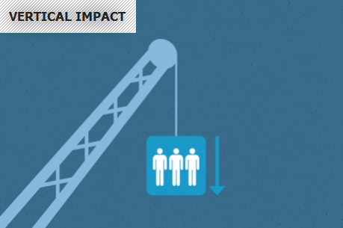
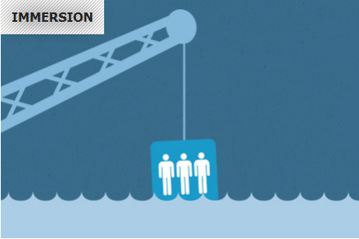
Key Risks
Notes:
3
3

Slide 4
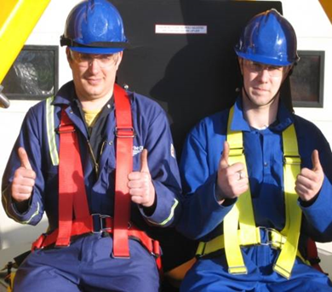
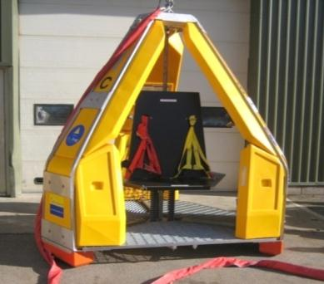
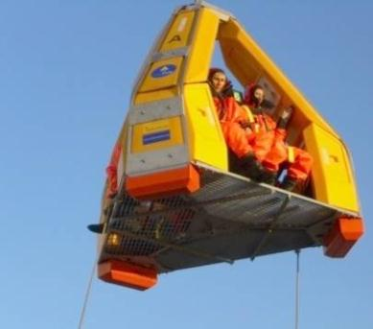
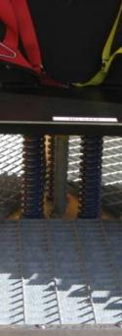
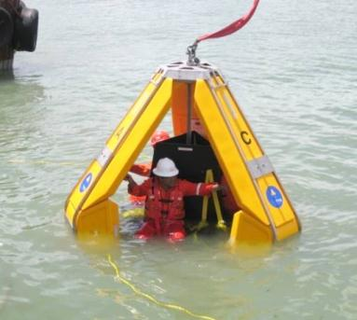
Designed to Protect
FALL PROTECTION
SIDE IMPACT PROTECTION
Fitted with 3 point harness
Rugged stainless steel protection frame
HEAVY LANDING PROTECTION
IMMERSION
Impact absorbing under-seat suspension, 3 x shock absorbing feet
Flotation and self-righting

Slide 5
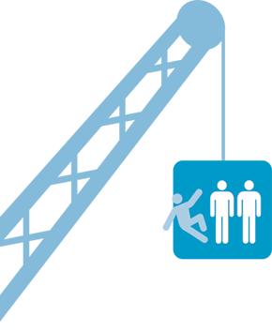
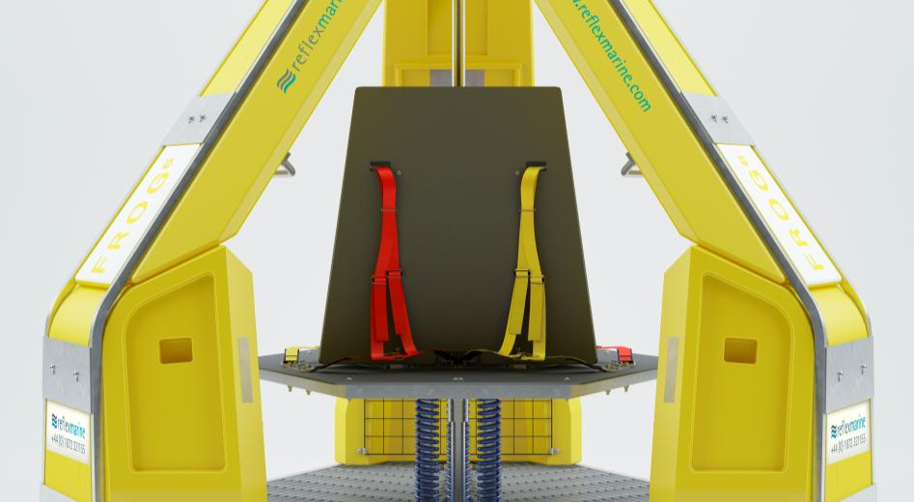
Fall Protection
55% of recorded incidents involve falling
Falling – Losing grip, knocked off, jumping to avoid collision
Grab handles
Quick release
3-point harness

Slide 6
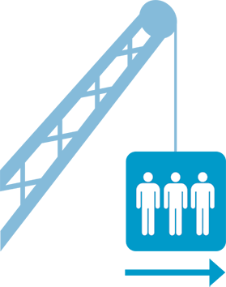
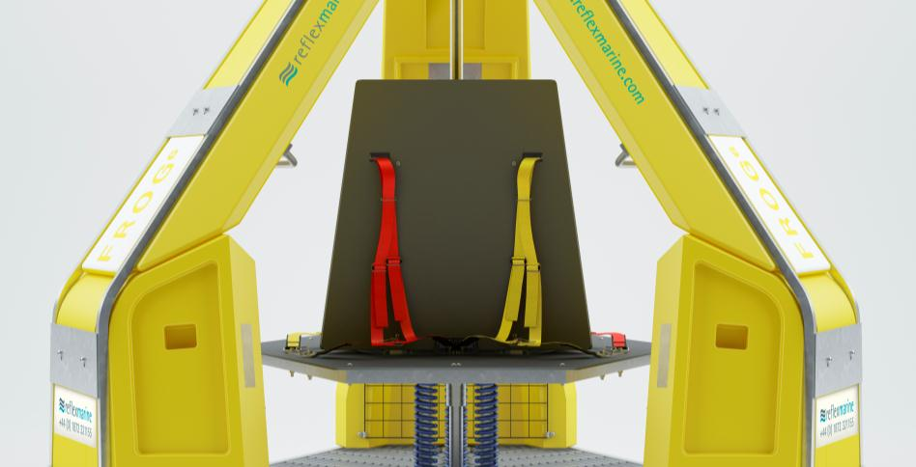
Side Impact Protection
Lateral impact protection of 2 m/s
Calculated and tested against the weakest 5% human spines and neck
Stainless steel frame
Foam-filled polyurethane buoyancy impact protection

Slide 7
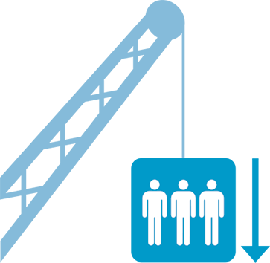
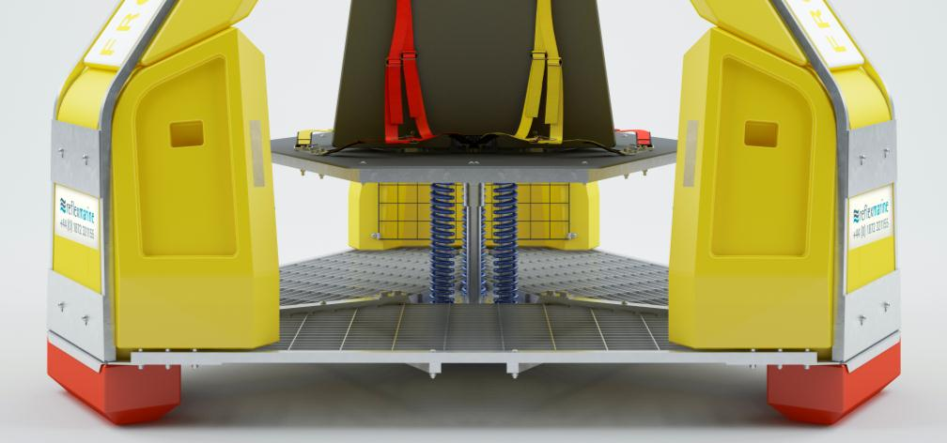
Heavy Landing Protection
Vertical impact protection of 4 m/s
Calculated and tested against the weakest 5% human spines and neck
Dampened steel spring suspension system
Shock absorbing feet

Slide 8
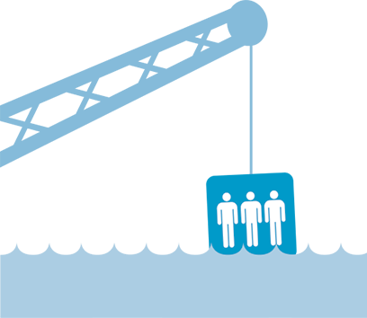
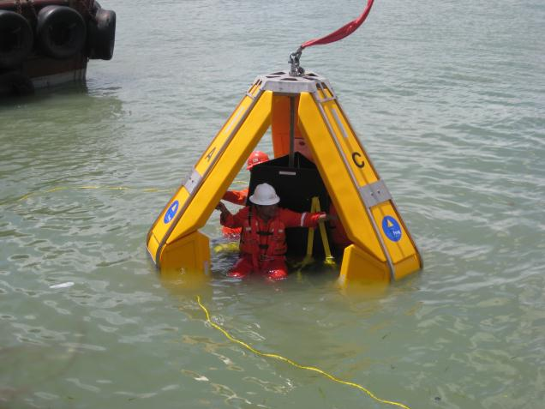
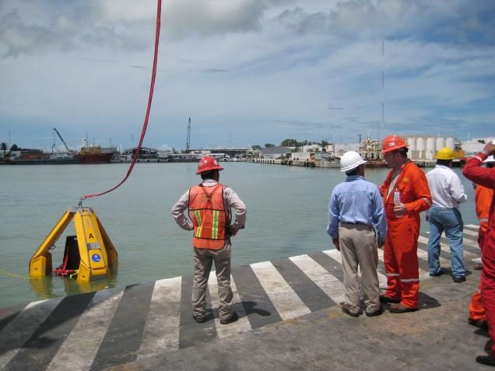
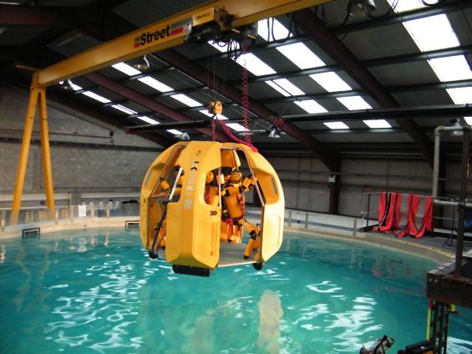
Immersion Protection
Self-rights up to 180° from inverted vertical position

Slide 9
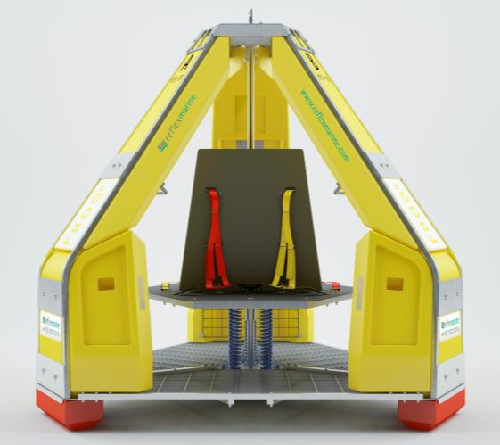
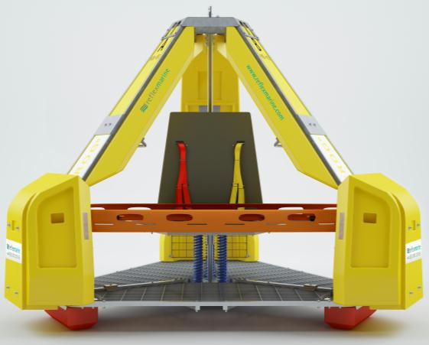
Other Features
6 person or 1 person + stretcher capacity
Suitable for MedEvac transfers
Suitable for medium volume crew changes
Standard and Arctic models
SWL of 570kg
CE Marked
ABS Approved

Slide 10
Using the frog-6

Slide 11
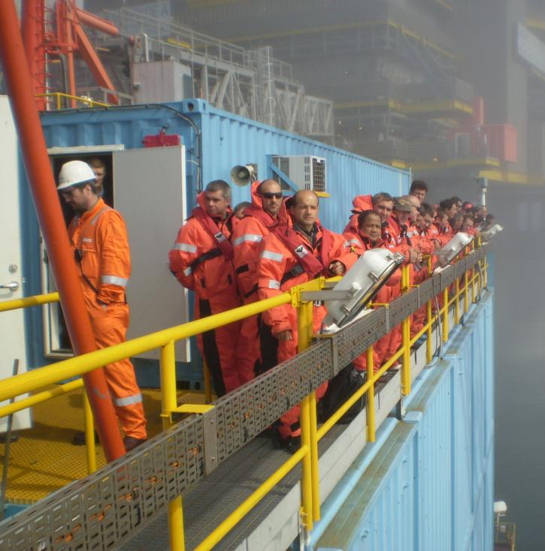
Personal Protective Equipment
Personal Floatation Device
Head Protection
Survival Suit (if required)
Other Operator specific PPE requirements

Slide 12
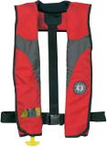
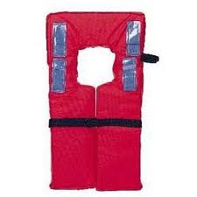
Personal Floatation Devices
Type | Image | Recommended | Comments
Manual inflatable lifejacket |  |  | 275N min rating Automatically inflatable may also be used
Yoke Style Lifejacket |  |  | Can interfere with operation of seat harness

Slide 13
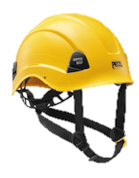
Head Protection
Type | Image | Recommended | Comments
Working at Height Helmet |  |  | Chin strap for secure fit Back of helmet should not interfere with seat
Hard Hat |  |  | Insecure fit Can interfere with seat

Slide 14
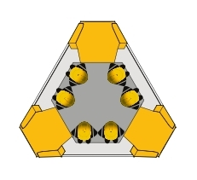
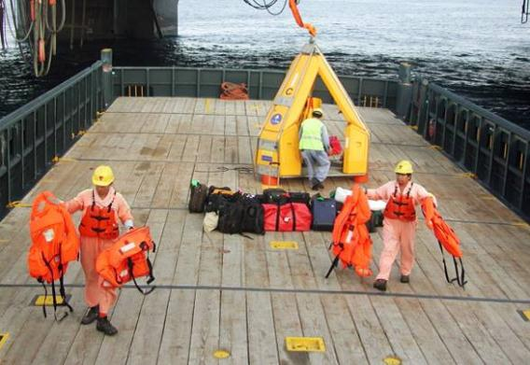
Before Transfer
Watch the User Briefing video
Check your life jacket is fitted correctly
Deck crew will assign you to a group
Deck crew will then assign you to a specific seat
Await entry instructions

Slide 15
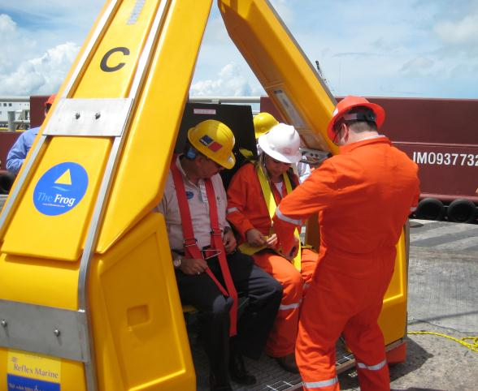
Entry
Enter carrier and take the seat in front of you
Fasten seat harness
Keep hands and feet inside the carrier
Hold the grab handles
Place feet flat on flooring

Slide 16
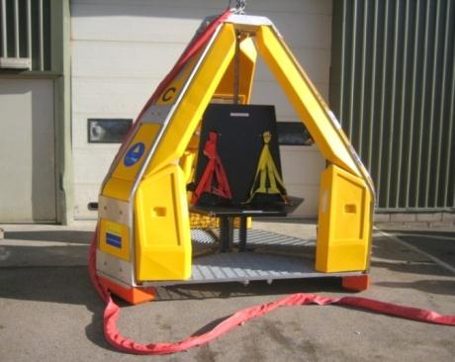
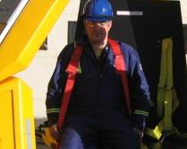
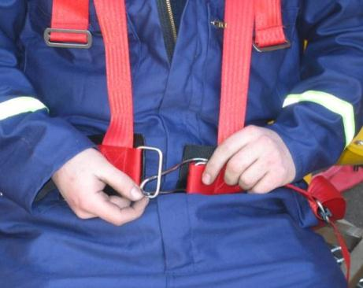
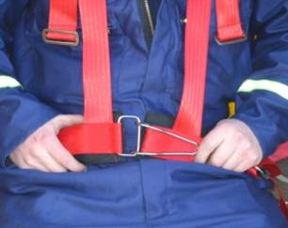
Fastening Seat Harnesses
Seat harnesses will have been prepared by the deck crew
Insert each arm into shoulder harness
1
2
Take the lap fastener clip and feed through the eye
Fold over clip
3
4

Slide 17
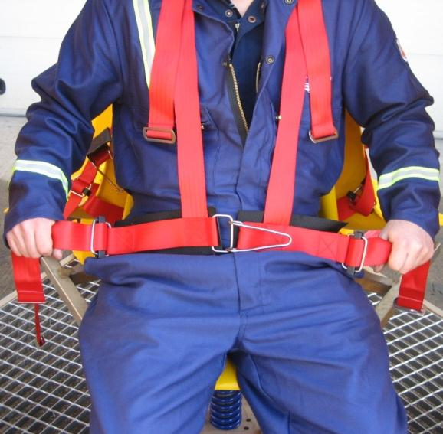
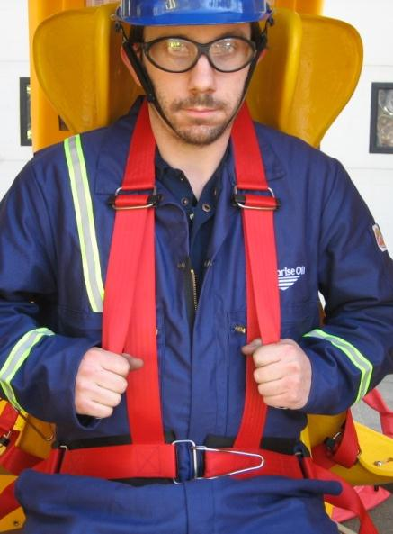
Fastening Seat Harnesses
PULL LOWER STRAPS FIRST to tighten around waist
PULL UPPER STRAPS SECOND to tighten fit around shoulders and chest
5
6

Slide 18
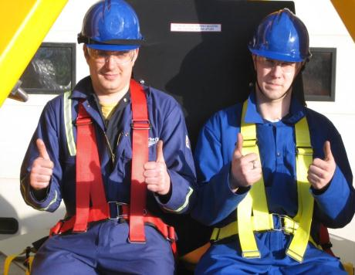
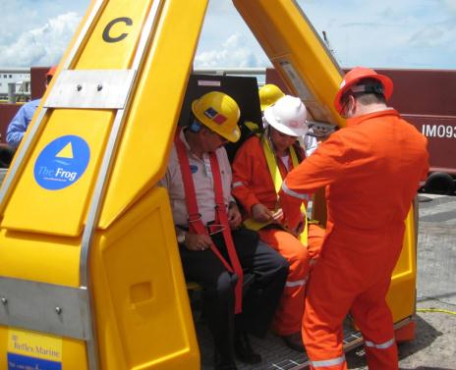
Ready for Transfer
Give a ‘thumbs up’ to indicate you are ready
Deck crew will carry out final check of your seat harness
During transfer:
Remain seated
Do not unfasten seat harness
Keep hands and feet inside the carrier at all times
Follow instructions from deck crew

Slide 19
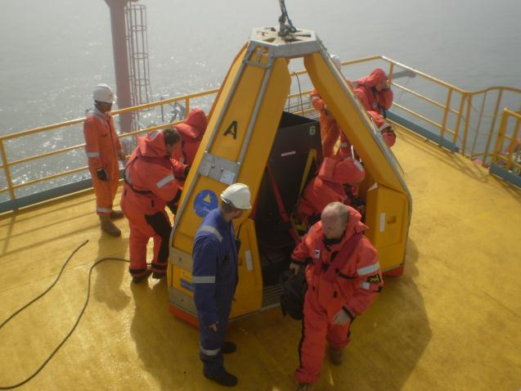
Exit
Await instructions from deck crew to unfasten seat harness
Exit in and orderly fashion
Remain clear of lifting assembly
Proceed to safe area as instructed
Return life jacket

Slide 20
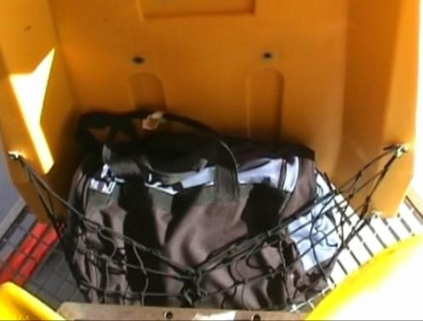
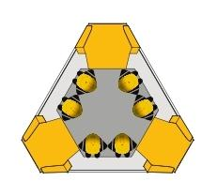
Luggage Storage
Luggage should be stored in the nets
Each passenger is permitted up to 5 kg
When instructed by the deck crew passengers should stow luggage in the nets prior to passenger entry
Upon exit, passengers should remove luggage once instructed by the deck crew that it is safe to do so

Slide 21
Emergency Procedure
The deck crew will shout “OUT-OUT-OUT”
Release safety harness and leave the carrier immediately
Deck crew will advise and direct you to a safe area
If the transfer is interrupted whilst between vessel and installation:
Remain seated and strapped in
Recovery procedures will be initiated
Await instructions

Slide 22
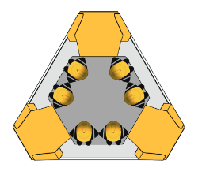
MedEvac Capability
Safe, comfortable and secure environment for walking casualties
Stretcher capability for serious injuries
Capacity for one passenger during transfer
Central column can be used to hang I.V/medical equipment
Known medical reasons – broken arms, broken legs, eye injuries, suspected heart attacks, back injuries

Slide 23
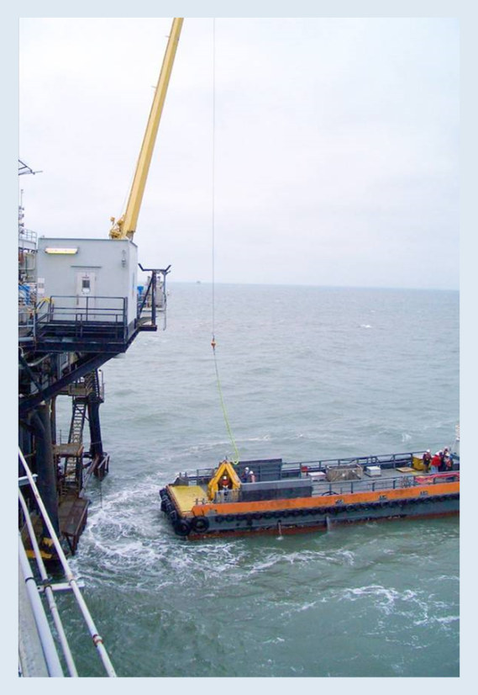
Feedback & Reporting
Feedback is important to improve:
Safety and comfort
Procedure and control
Operating performance
Equipment condition
Report all incidents and near misses no matter how small they may seem, if in doubt ask

Slide 24
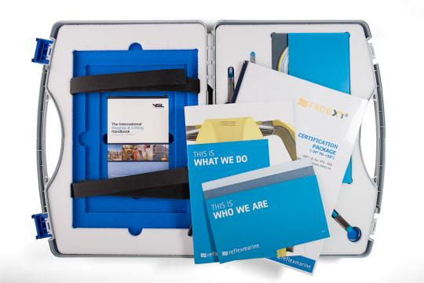
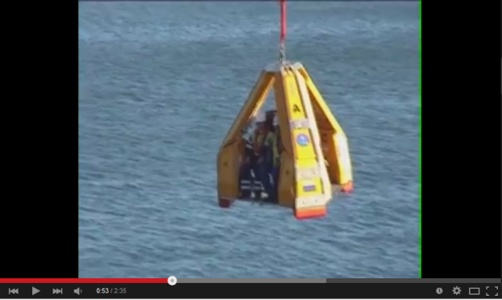
Resources
Here are some useful links for your reference:
FROG-6 Passenger Briefing Video
General Briefing Videos
www.reflexmarine.com

